Slide 1
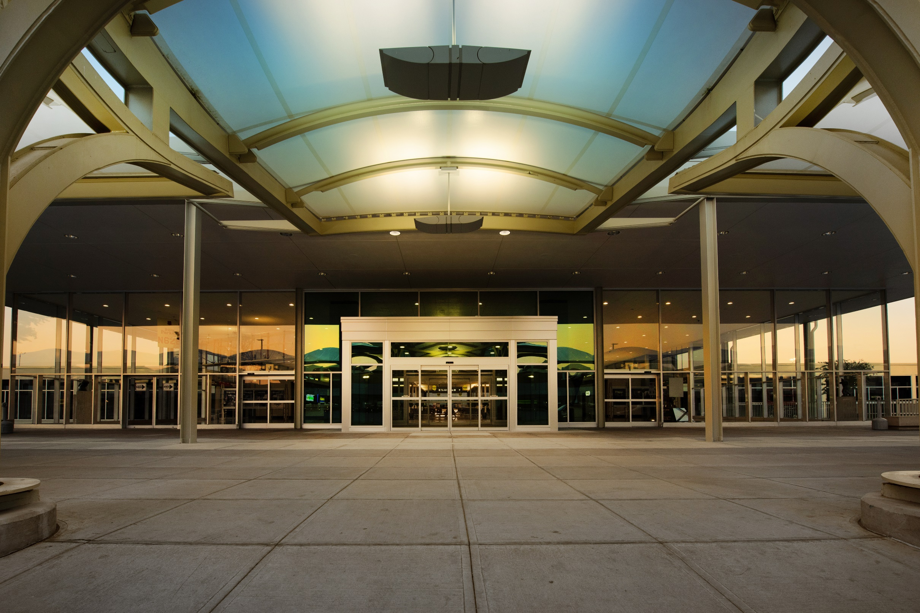

Disadvantaged Business Enterprise (DBE) Outreach
November 30, 2022

Slide 2
Participants and Presenters
Tulsa Airports Improvement Trust
Sandra Charon, ACDBELO
Frank Relja, Director of Engineering & Planning
Brian Aussieker, Senior Engineer
Lee Shaw, Airport Engineer
Oklahoma Department of Transportation (ODOT)
La Tashia Thompson, Supportive Service Coordinator, Civil Rights Department
Kellye Johnson, Disadvantaged Business Enterprise Supportive Services

Slide 3
Agenda
Welcome and Introduction
Tulsa Airports Improvement Trust Background
Disadvantaged Business Enterprise
Capital Improvement Projects
FAA Grant Funding
Project Bidding Process
DBE Requirements
OKDOT Opportunities and Certification
Closing Remarks
Networking Opportunities - Q & A

Slide 4

About Tulsa
Tulsa is a medium sized city with a growing population (~1M MSA) and economy that anchors the Northeast Oklahoma region
An aviation hub, Tulsa is home to over 275 aviation companies that generate over $11.7 billion in economic impact annually
Over $1.1B in capital investment in Northeast Oklahoma over the past four years

Slide 5

TUL Passenger Recovery
Tulsa passenger recovery has returned above 100% of pre-pandemic levels since July and 107% in September
Source: OAG Schedules and TUL Passenger Numbers

Slide 6
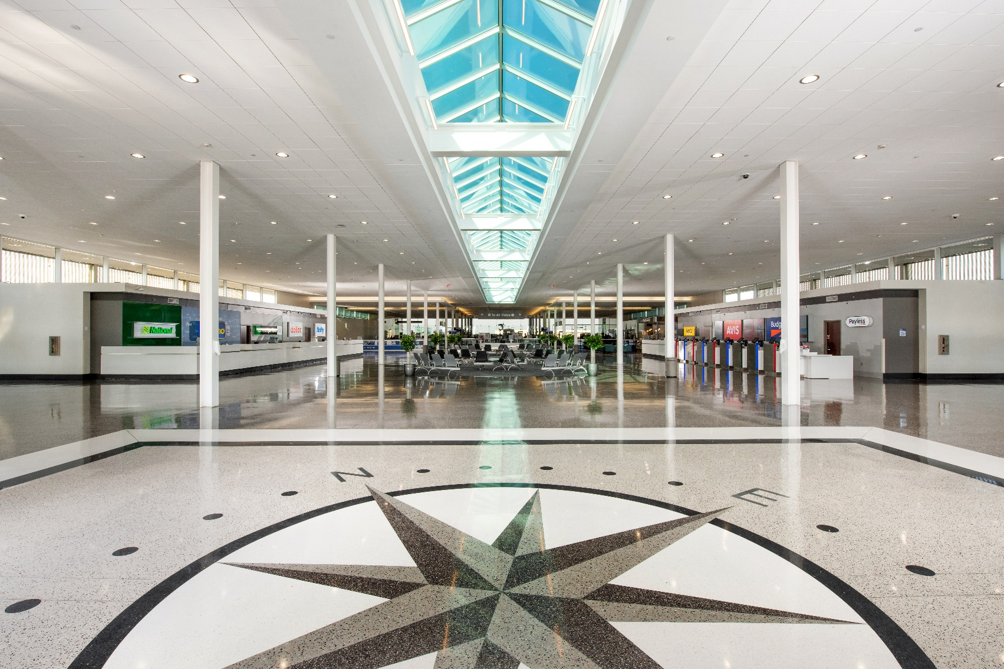
TUL Updates
TUL Updates
Air Service
Terminal Improvements
Industrial Improvements
Customer Experience

Slide 7
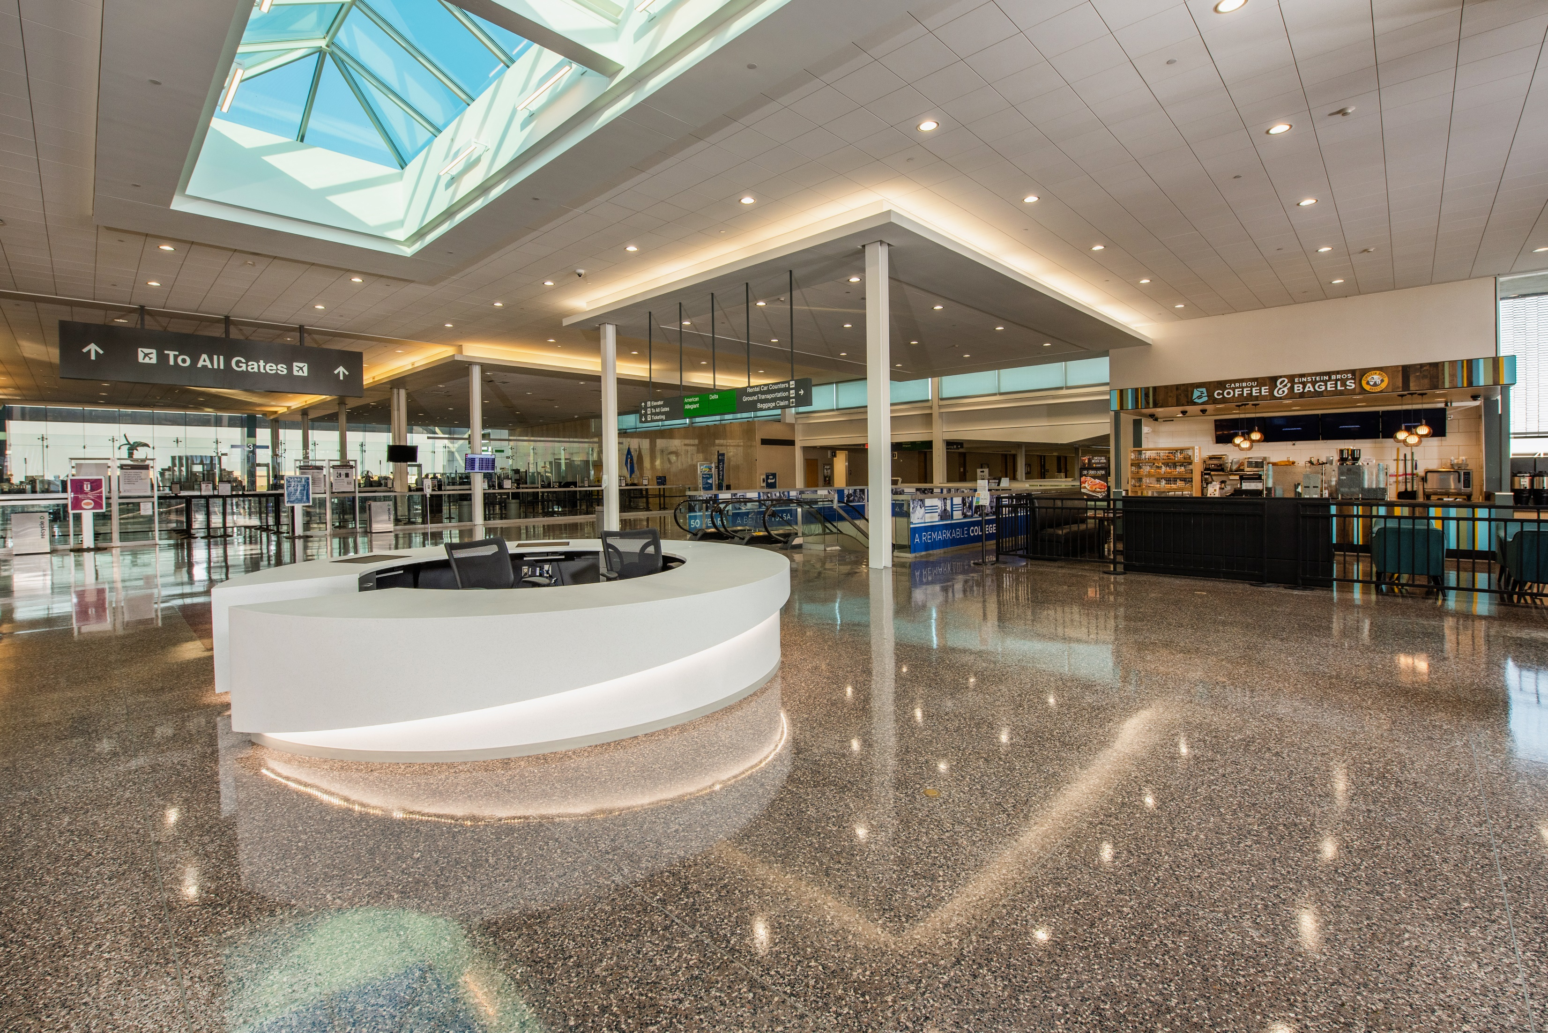
Business Diversity
What does business diversity mean to Tulsa International Airport?
It means helping to grow opportunities for our minority small businesses.

Slide 8
Disadvantaged Business Enterprise Program
Tulsa Airports Improvement Trust (TAIT) is committed to valuing differences and nurturing diversity.
TAIT strives to create opportunities for Minority Disadvantaged Business Enterprises and Airport Concession Disadvantaged Business Enterprises (ACDBE) in all airport related services.

Slide 9
DBE and ACDBE Program
DBE and ACDBE Program
Tulsa Airports Improvement Trust (TAIT), has established a Disadvantaged Business Enterprise (DBE) program in accordance with the Regulations of the U.S. Department of Transportation (DOT), 49 CFR-Part 26 and Part 23.
TAIT receives federal financial assistance from the Department of Transportation, and as a condition of receiving this assistance, TAIT has signed assurances that we will comply with the Federal Regulations and ensure that DBE’s & ACDBE’s have an equal opportunity to receive and participate in DOT-Assisted contracts.

Slide 10
DBE and ACDBE Program
What is the difference?
A Disadvantaged Business Enterprise (DBE) is a business primarily engaged in the construction industry, that offers services that can participate in state highway, transit, and airport projects
An Airport Concession Disadvantaged Business Enterprise (ACDBE) is a business engaged in the sale of goods/ or services to the public or a business that provides goods and services to those businesses located at the airport.
A business that does not have an office, store or other type of location on the airport premises may still be considered a concession if activities take place at the airport.
Advertising
Web-based or electronic businesses that can be accessed at the airport
Businesses that provide goods and services to our concessionaire

Slide 11
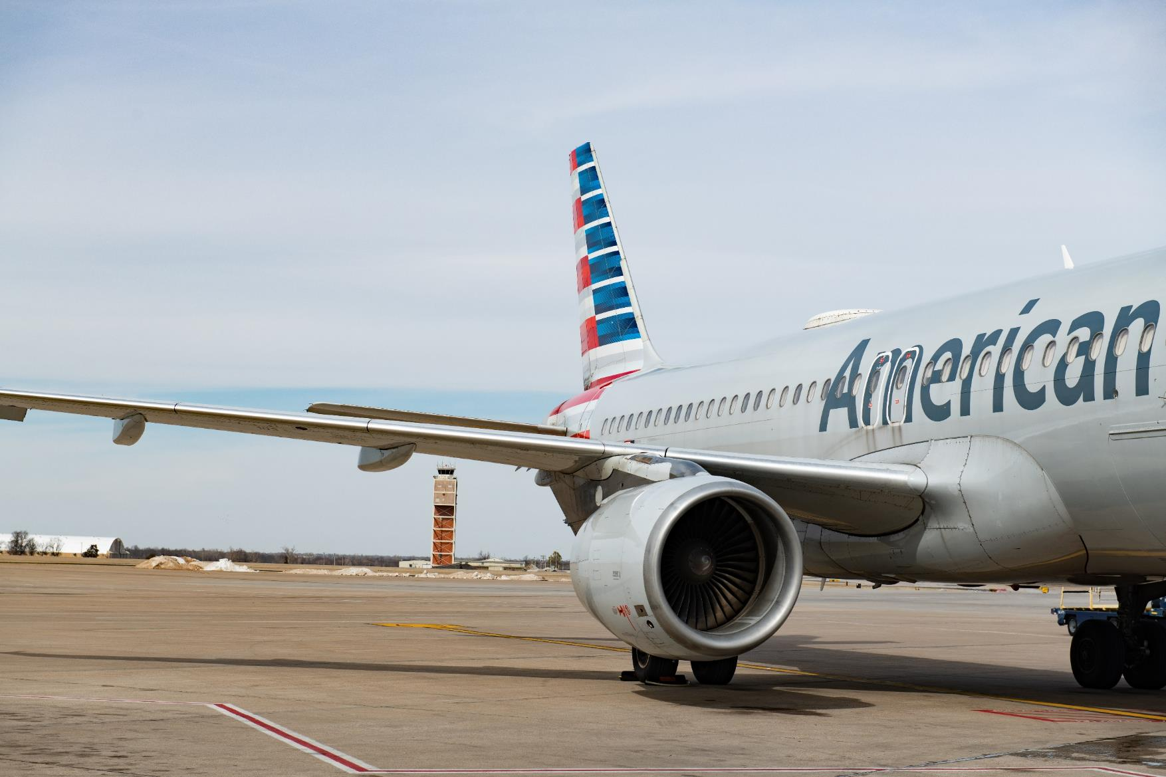
Projects in
Progress = $119.7M

Slide 12
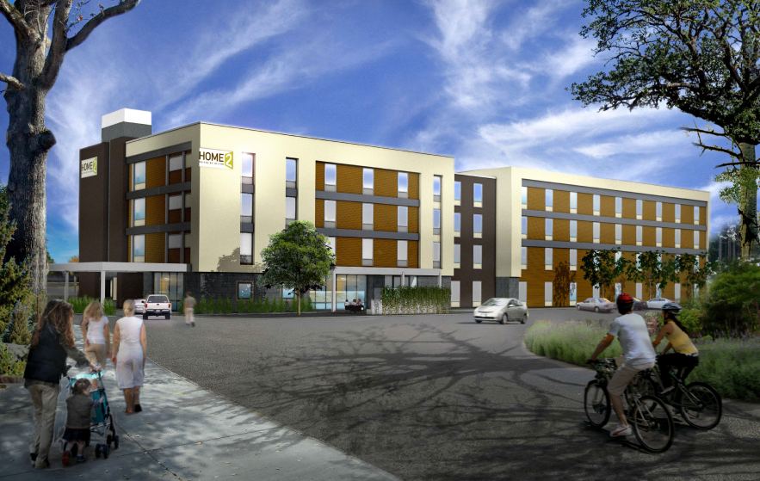
Hotel
Construction
Home 2 Suites by Hilton
Hotel Groundbreaking: May 2022
Expected Completion: Summer 2023

Slide 13
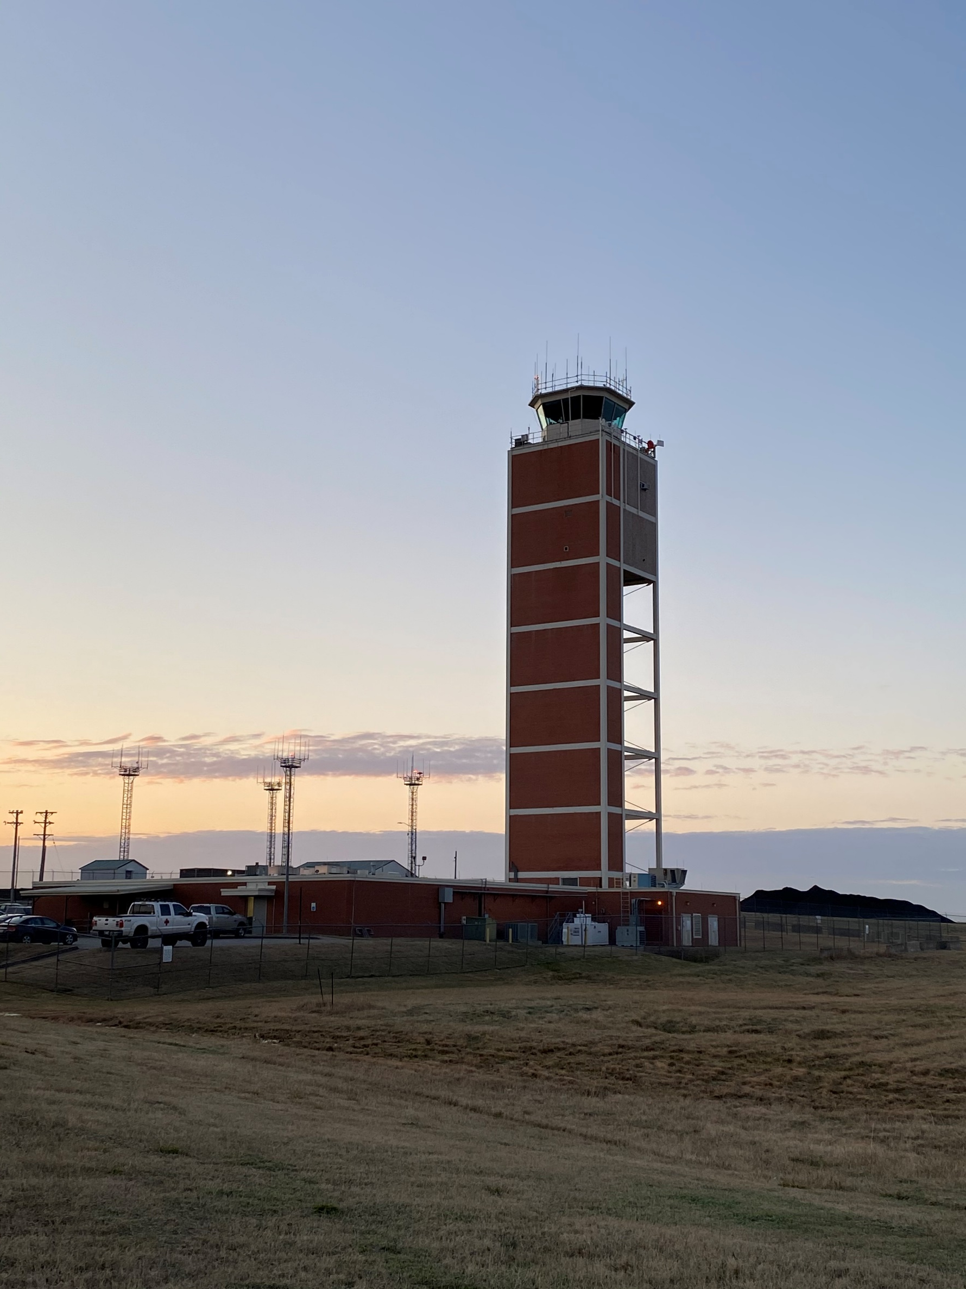
Air Traffic Control Tower & Base Building Replacement
This $94M project replaces the 61 year old tower built to accommodate technology used in the mid 20th century, including tele types and transistor radios. The new tower will stand 234’ to eye level in the tower cab and include the latest in air navigation technology and equipment.
Architect: LEO A DALY

Slide 14
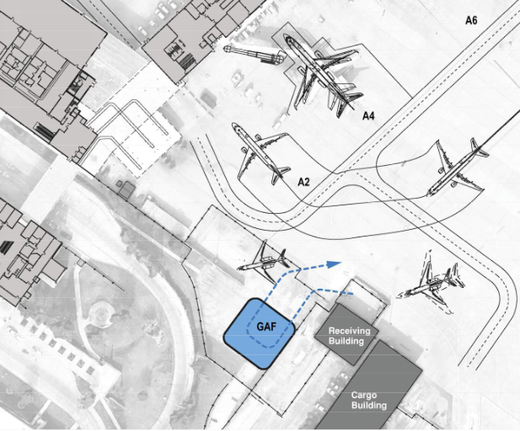
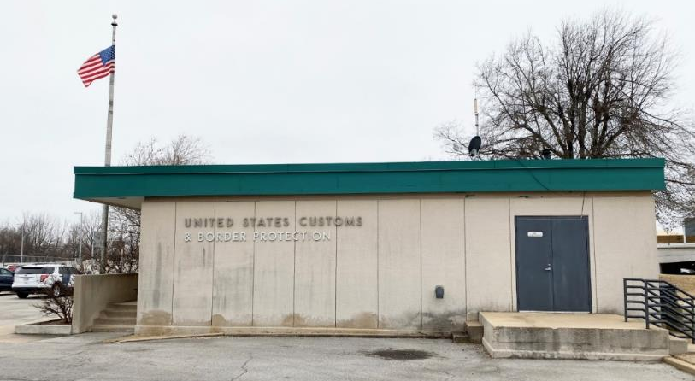
CBP – GAF/FIS - $30M
This $15M project includes construction of a new General Aviation Facility to support CBP’s operation making Tulsa an international port of entry for flights with 20 or fewer passengers. A Federal Inspection Service facility will also be built to allow processing of international commercial passenger flights.
Architects: Corgan & Associates, Selser Schaefer

Slide 15
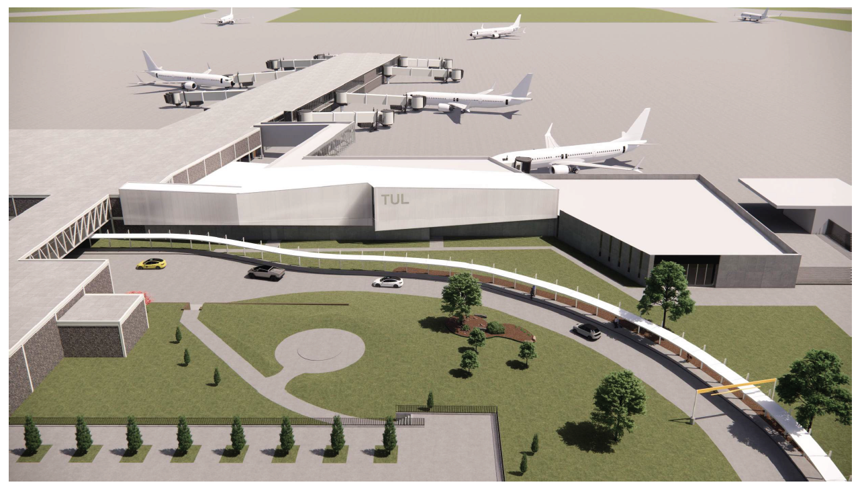

Slide 16
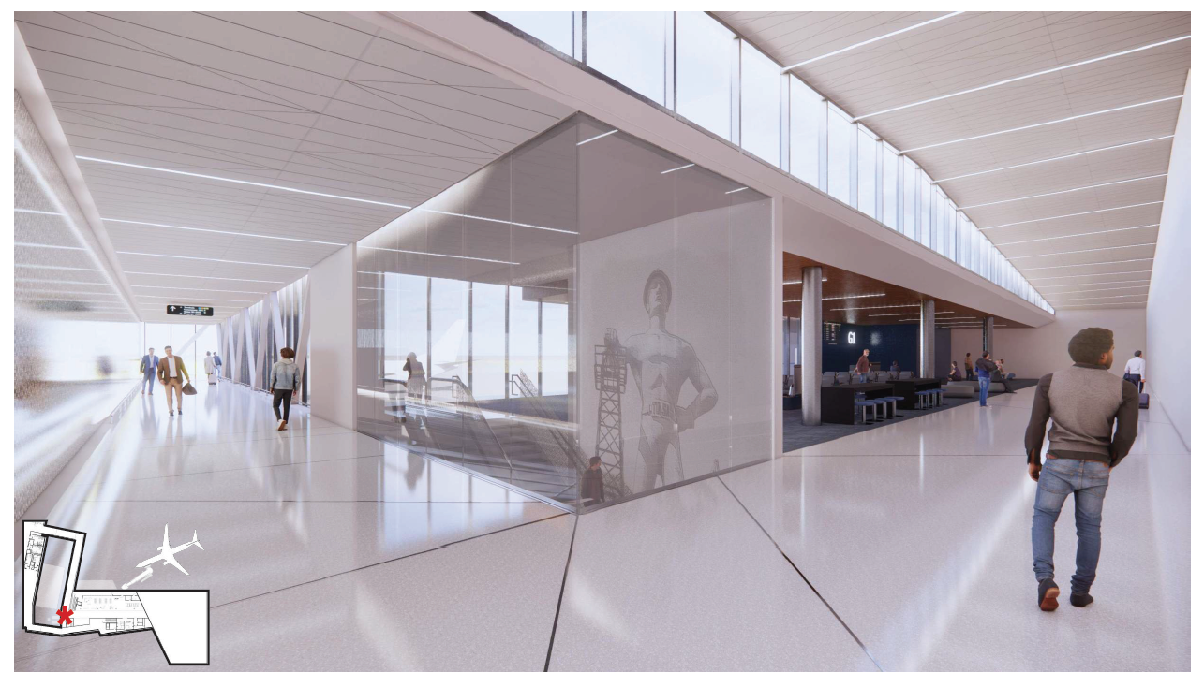

Slide 17
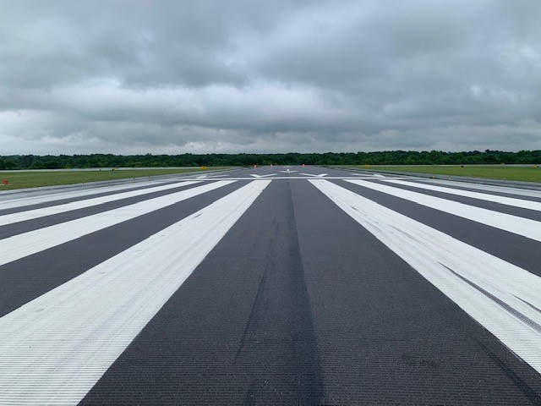
Runway 18R-36L Improvements
$13,400,000
Architect: ATKINS
Prime: APAC-Central
Complete August 2022

Slide 18
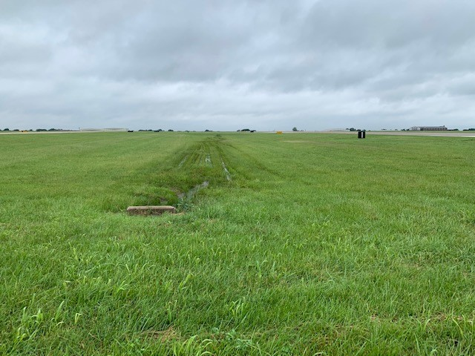
Runway 8-26 Safety Area Improvements
$795,327
Architect: Benham Design, LLC
Prime: Daris Contractors
Complete August 2022

Slide 19
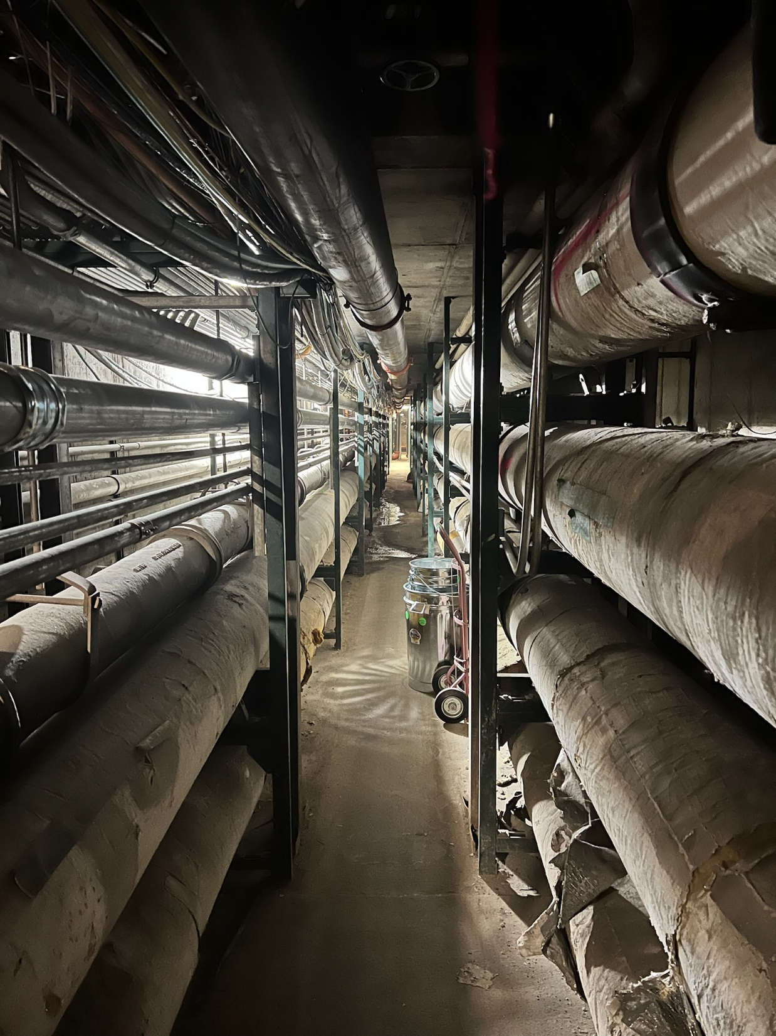
Tunnel Clean Up
Pre-Construction
$1M
General Contractor: Myers Cherry
Planned completion date: 2023

Slide 20
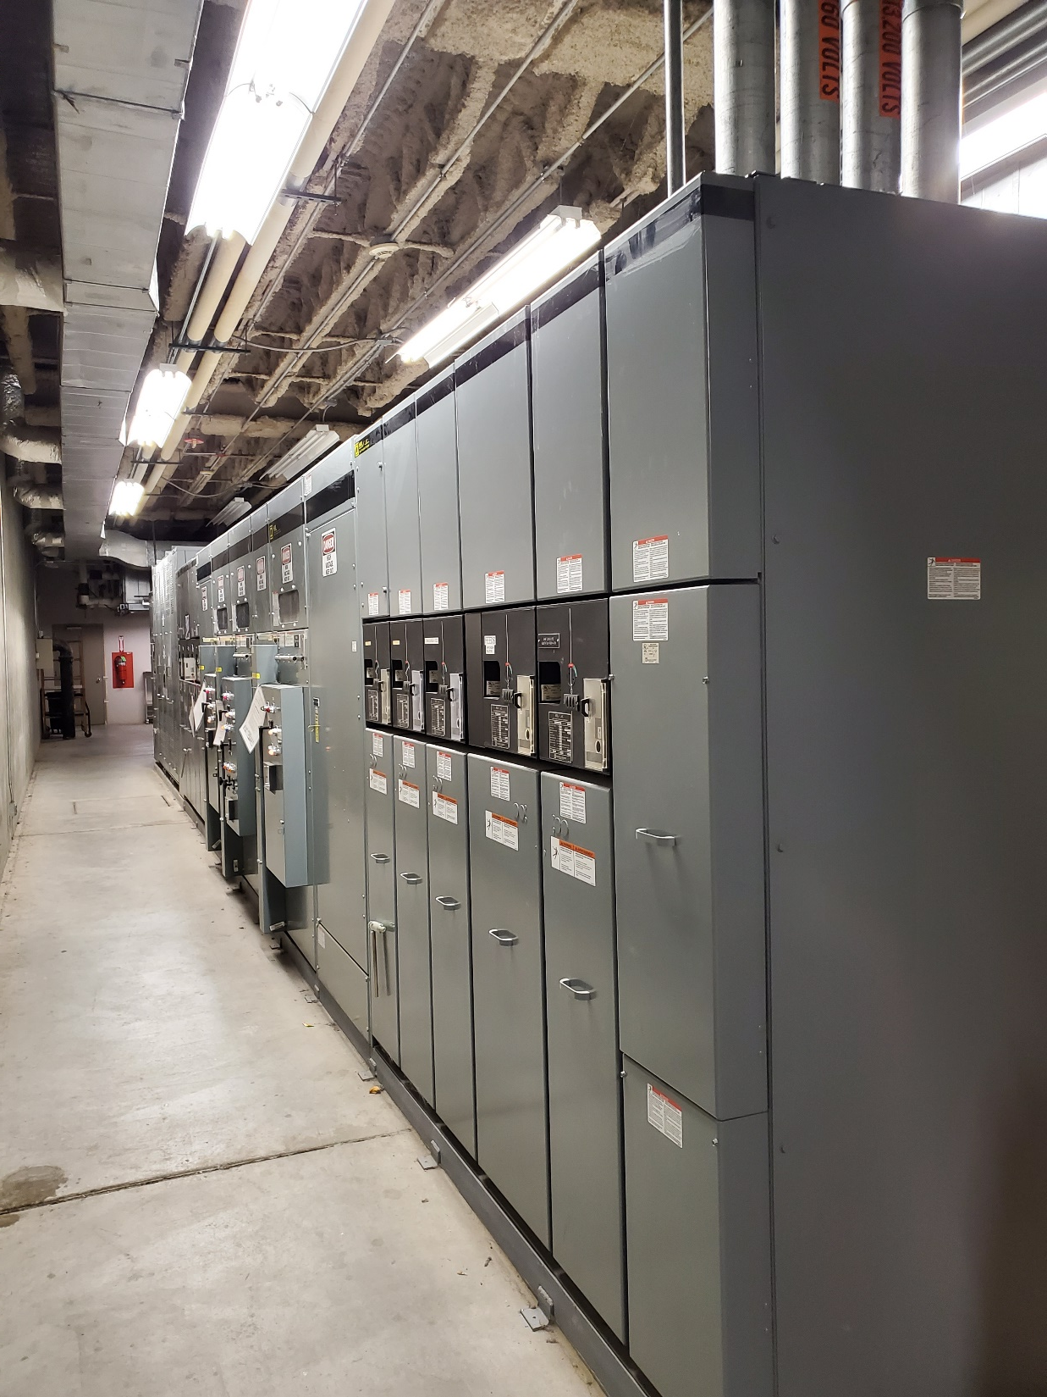
TUL ARC Flash Study
$350,000
Consultant: Garver
Planned Completion Date: June 2023

Slide 21

Mezzanine Roof Replacement
$755,994
Architect: GH2
General Contractor: Atwell Roofing
Planned completion date: 10/2022

Slide 22
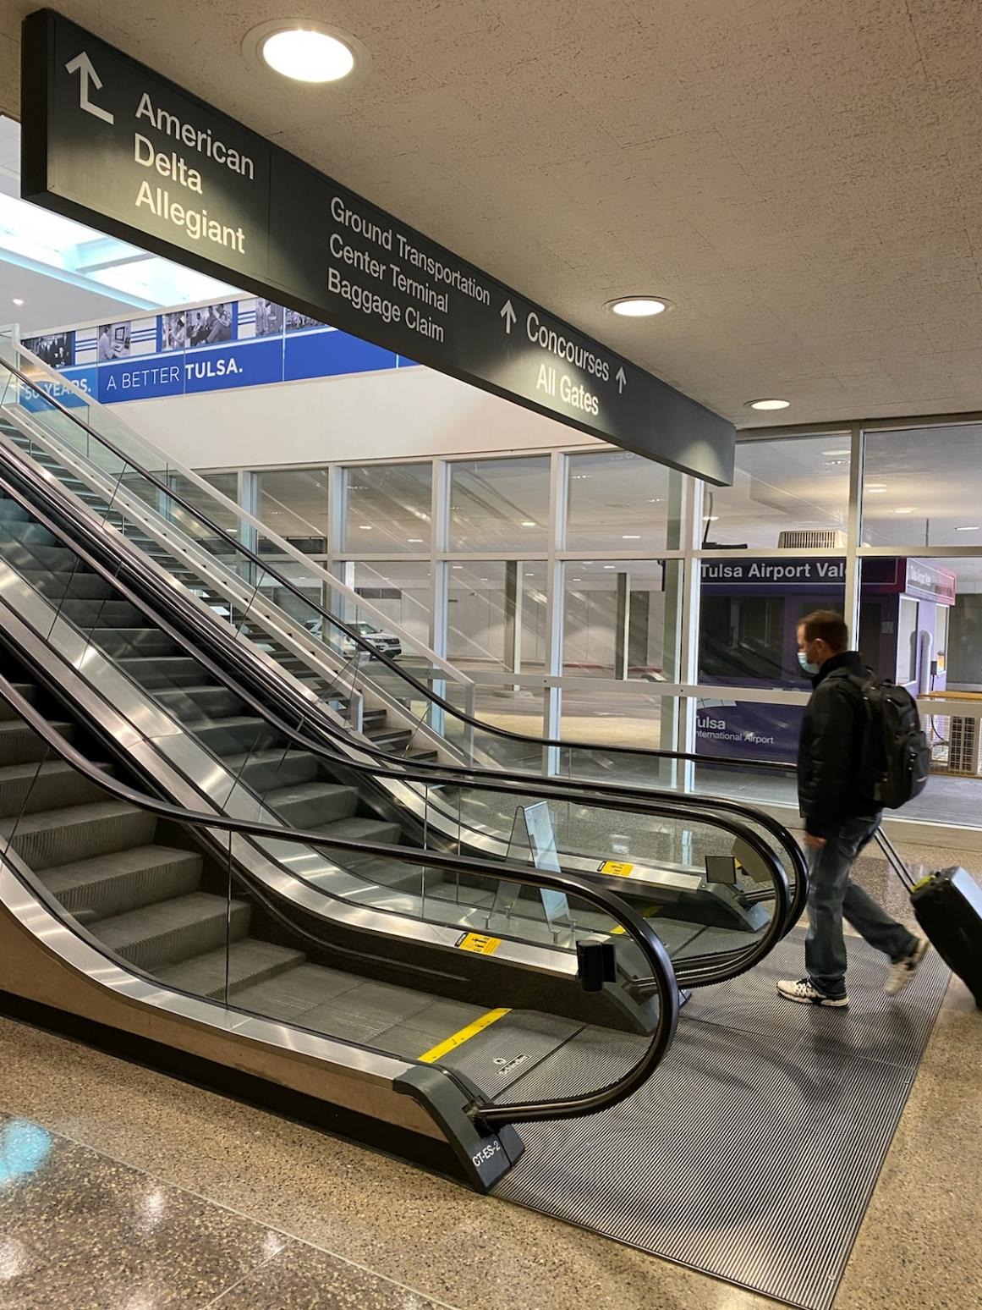
Escalator Replacement
$1,211,431
Architect: Todd Architectural
General Contractor: Keith Construction
Planned completion date: 3/1/23

Slide 23
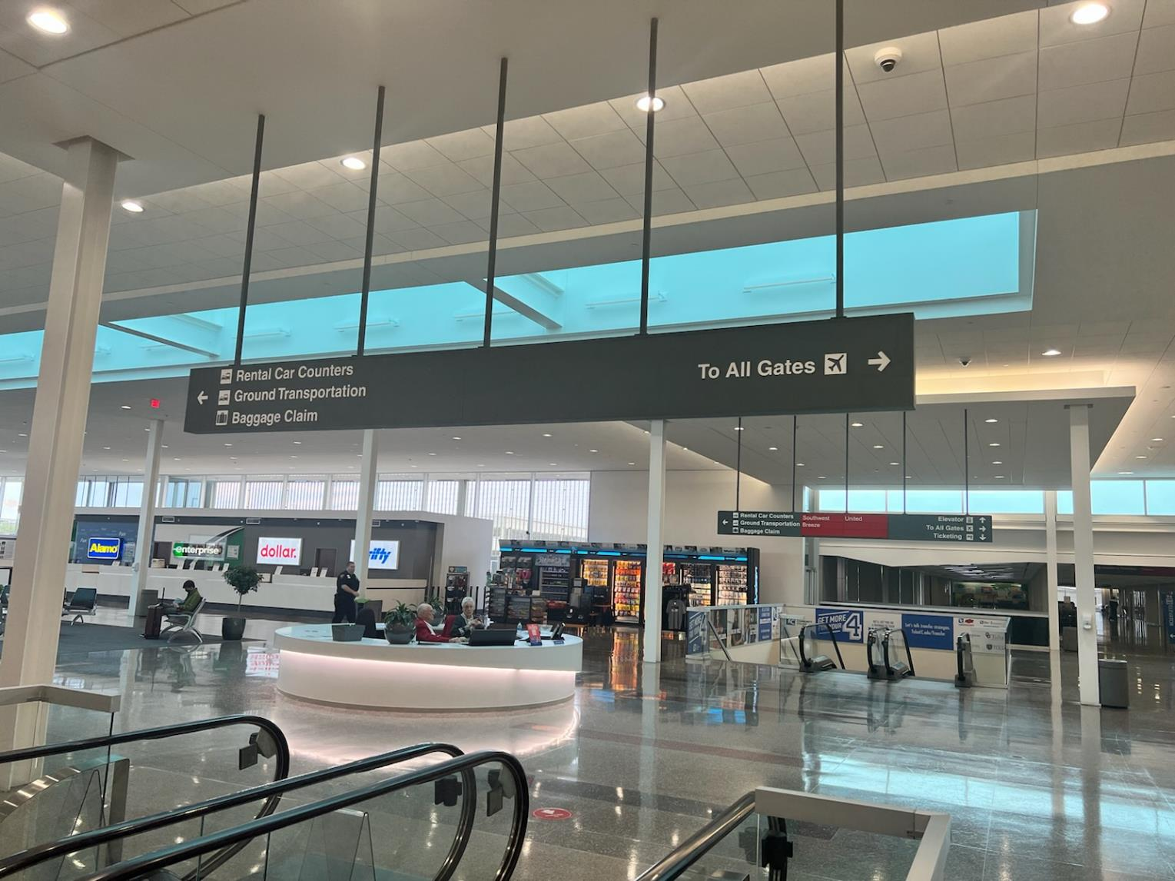
Wayfinding Design
Master Plan
(Phase 1 Design)
$1,350,000
Project Consultant: Gresham Smith

Slide 24
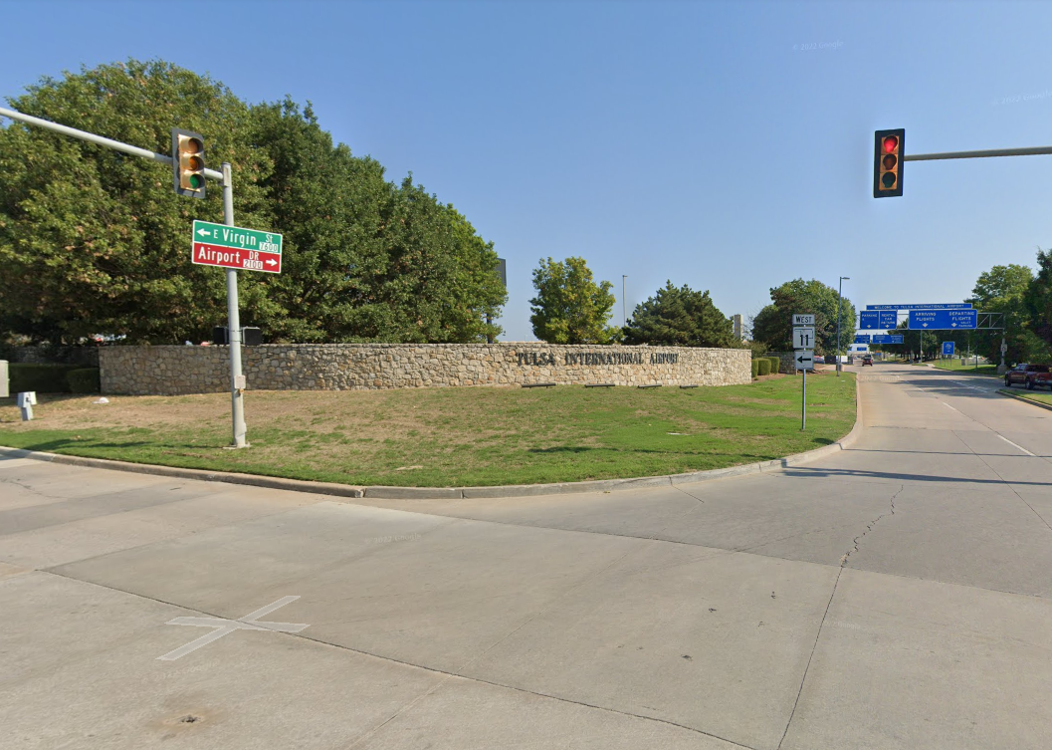
Monumental
Roadway Signs
(Design & Construction)
$1,000,000
Project Consultant: Gresham Smith

Slide 25
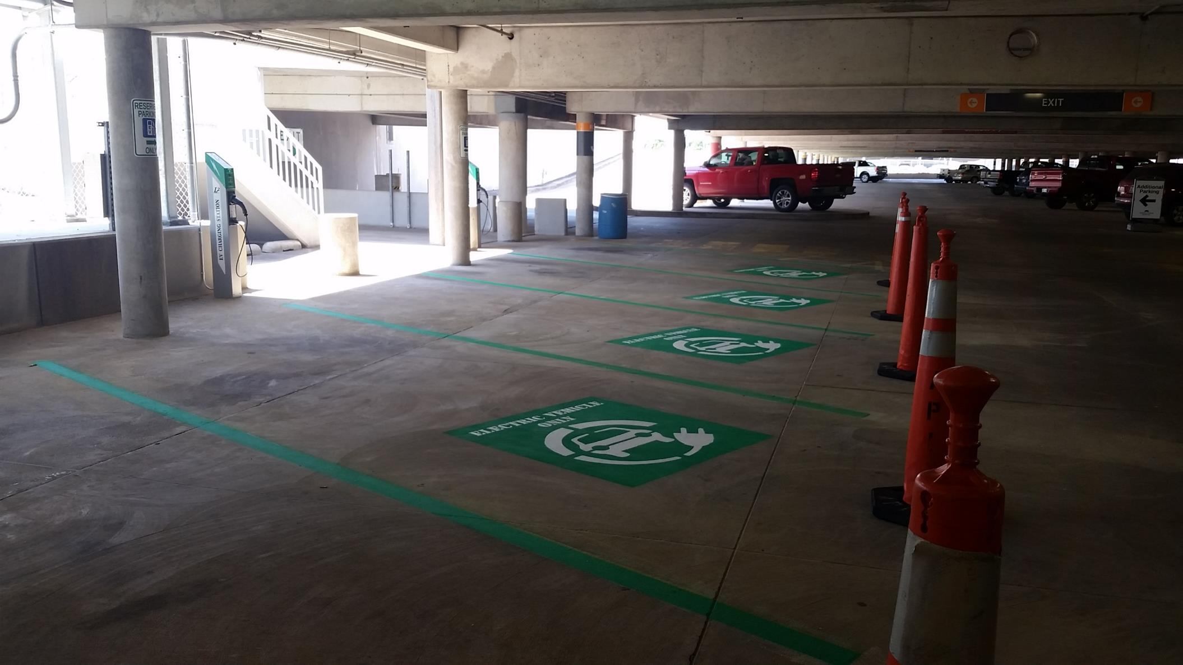
EV Charging Stations
Installation in Garage
$1,335,000

Slide 26
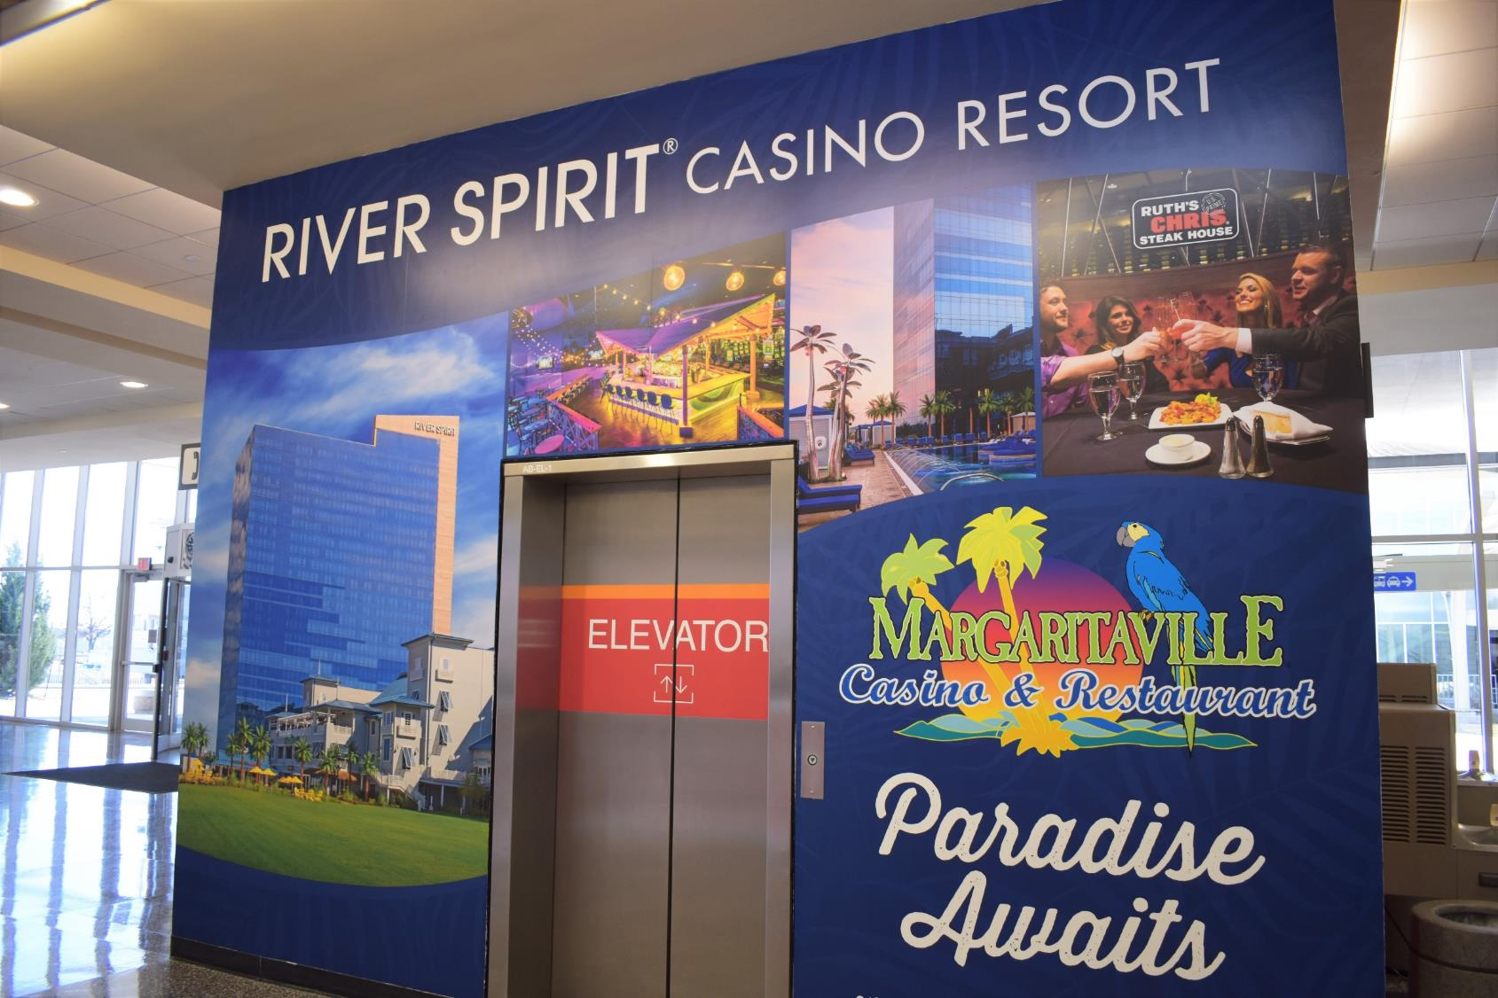
Modernize Terminal
Elevators (4)
$800,000

Slide 27
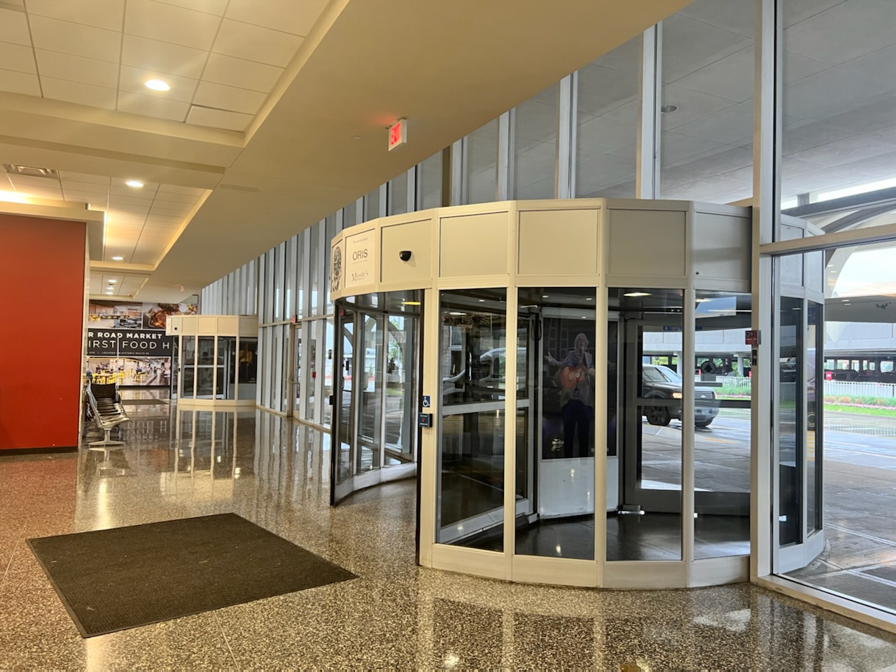
Vestibule Entrances
(4 bag claim & 4 ticketing - Design)
$320,000

Slide 28
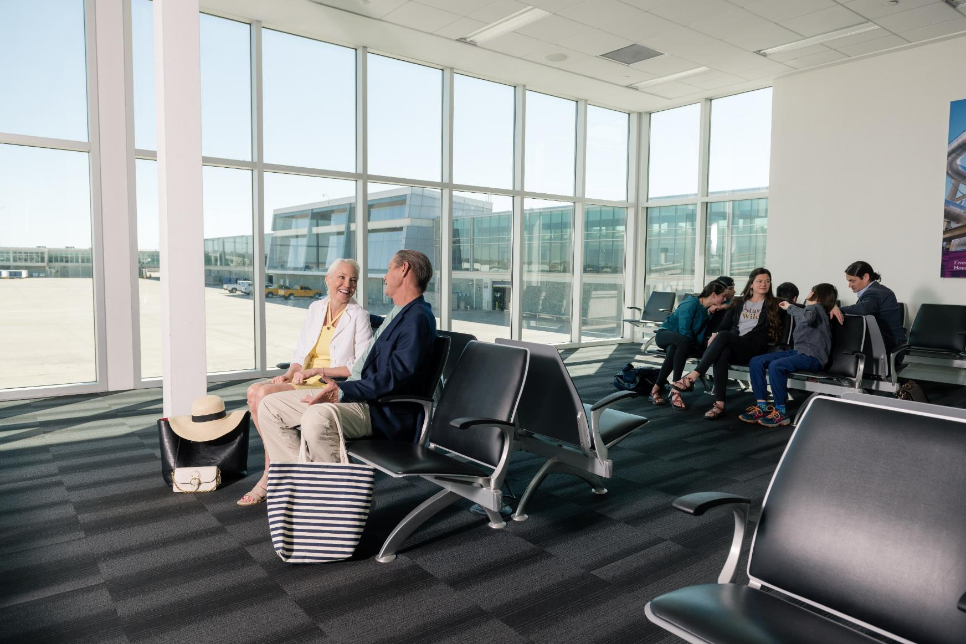
Update Terminal
Building Furniture
$500,000

Slide 29
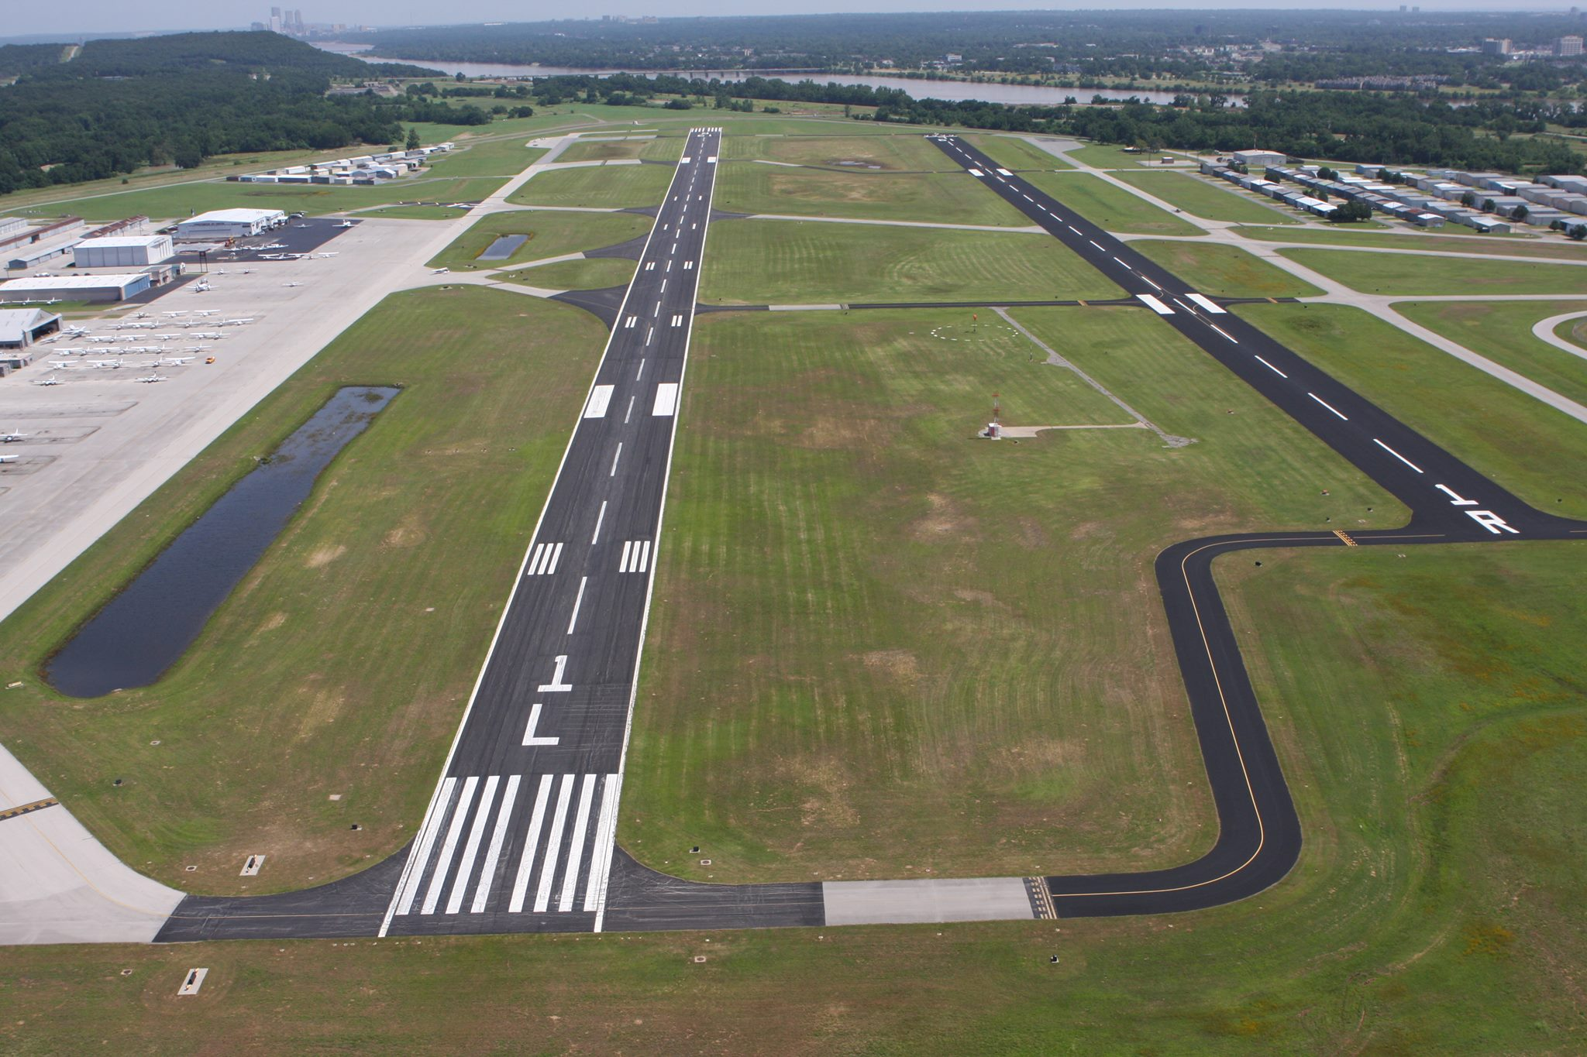

Taxiway Connectors
$5,400,000
Architect: Olsson
Construction: Spring 2023

Slide 30
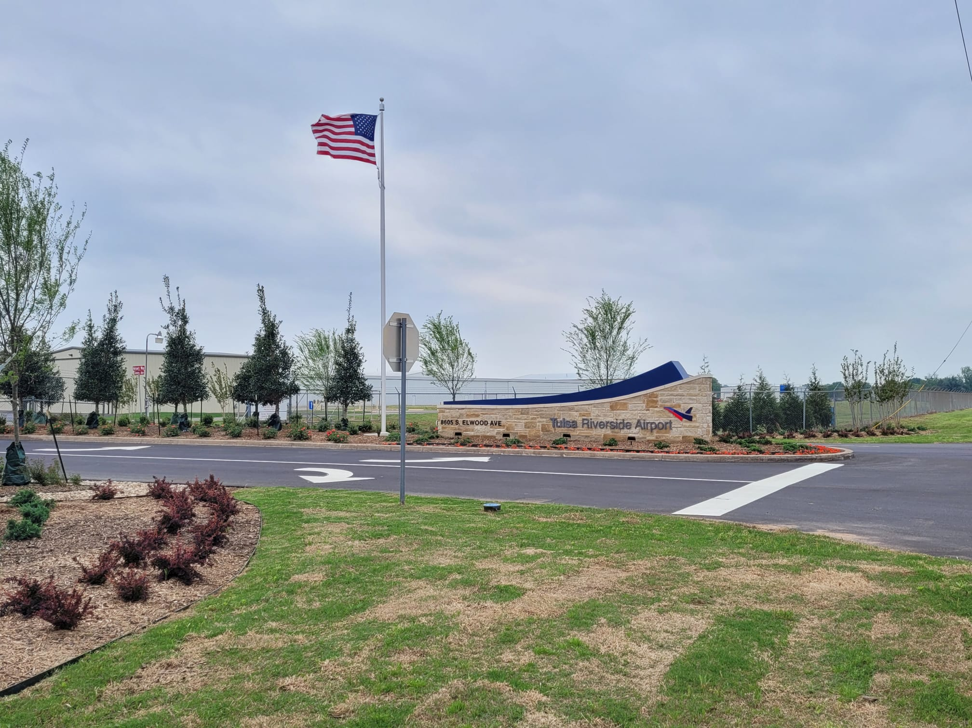
Master Plan Update
$607,229
Project Consultant:
RS&H

Slide 31
Rehabilitate Service Road (Construction)
Airfield Guidance Sign Upgrade
Federal Inspection Service
Install Electric Vehicle Charging Stations (Parking Garage)
Way Finding Upgrade (Design & Construction)
Replace Revolving Doors Ticketing Area with Vestibules
Replace Existing ATCT
Field Maintenance Building Roof & Exterior Rehabilitation
Exit Lane “B” Exit Door Upgrade
Modernize Four Terminal Elevators
Replace ARFF Vehicle
Update Airfield Pavement Management System (PCI)
AC Pavement Reseal Employee Lots
Improve RSA Runway 18R/36L - EMAS RW 36L (Design & Construction)
Reconstruct Taxiway Kilo
Rehabilitate Taxiway Mike
Improve Airport Terminal Public Restrooms Lower Level (Design & Construction)
Improve Security Fencing (Design and Construction)
Rehabilitate Cargo Landside Pavement
Install EV Charging Stations (Airport Vehicles)
Repair QTA Parking Lot
Terminal Apron Rehabilitation (Design)
Improve Airport Terminal AHU
Improve Airport Terminal Windows
Valet Storage
Capital Improvement
Plan Projects
FY 2023-2027

Slide 32
TAIT Capital Improvement Totals
FY 2022-2025
PROJECTED FAA FUNDING
PROJECT TOTAL
2022 $8,100,000
2023 $110,575,000
2024 $32,400,000
2025 $5,200,000
2022 $2,600,000
2023 $12,300,000
2024 $12,600,000
2025 $2,500,000

Slide 33
Areas of Opportunity
Contractors
Subcontractors
HVAC
Pavement-Stripping
Surveying
Erosion Control
Storm Drainage
Consulting
Fencing
Cement
Asphalt
Materials
Testing
Signage
Drywall
Carpentry
Earth Moving
Land Clearing
Electrical
Boilers Roofing
Drywall
Fire Suppression
Boilers
Flooring
Tile
Terrazzo
Steele Rebar
Public Furnishings
Canopies
Window covering
Elevator
Escalator
Pavement
Airfield Maintenance
Lighting
Sod
Landscaping
Traffic Safety
Barricade
Windows
Framing
Surgical (Personal Protective Gear)
Insurance

Slide 34
TAIT Business Opportunities List
.
1. Go to the website of www.tulsaairports.com
  About Us
  Business Opportunities
  Consultants
  Contractors
The following list consists of contractors and consultants for planning, design, construction or construction administration services that have expressed interest in bidding on Tulsa Airports Improvement Trust (TAIT) contracts. Presence on this list is not an endorsement or recommendation by the TAIT nor is it a guarantee of quality or completion of work by the contractors. This list should not be considered conclusive or restrictive. If any contractors or consultants would like to be added to the list, please e-mail contractorlist@tulsaairports.com or consultantlist@tulsaairports.com.
When the TAIT issues bid documents a staff member will e-mail the Notice to Bidders to all contractors on the list, inviting them to request bid documents. With this page, TAIT intends to provide clarity in its competitive bidding process and include all interested contractors.

Slide 35
TAIT Bidding Process
TAIT Team (Engineer or Architects) selected based on qualifications
Advertise Bidding
  Tulsa World Newspaper
  TAIT Website (www.tulsaairports.com ), under About Us, Business Opportunities
  Email Notice to Bidders
  Email Contractors on TAIT website list
TAIT hosts a Pre-Bid Conference
Open Sealed Bids
TAIT Staff recommends Award (to Low Bidder)
TAIT Board of Trustees Award project (or not).
Design of Project

Slide 36
Insurance Requirements
LANDSIDE PROJECT
Commercial General Liability
Auto Liability, Including all owned hired and non-owned automobiles
AIRFIELD PROJECT
Commercial General Liability
Auto Liability, Including all owned hired and non-owned automobiles
TERMINAL APRON PROJECT
Commercial General Liability
Auto Liability, Including all owned hired and non-owned automobiles
$1 Million Per Occurrence/$1 Million Aggregate, including Premise Operations Products and Completed Operations; Blanket Contractual (including Provisions for Contractor’s Obligations); Personal and Advertising Injury.
$1 Million Combined Single Limit
$5 Million Per Occurrence/$5 Million Aggregate Including Premises Operations; Products and Completed Operations; Blanket Contractual (including Provisions for Contractor’s obligation); Person and Advertising Injury
$5 Million Combined Single Limit
$10 Million Per Occurrence/$5 Million Aggregate Including Premises Operations; Products and Completed Operations; Blanket Contractual (including Provisions for Contractor’s obligation); Person and Advertising Injury
$10 Million Combined Single Limit

Slide 37
Bond Requirements
In addition to the insurance required above, the Contractor shall obtain, at its expense, an Owner’s and Contractors’ Protective Insurance policy covering the Work to be performed by the Contractor for the Owner specifically naming TAIT, the Tulsa Airport Authority and the City of Tulsa as insureds with the same limits as set forth for the Project category identified and set forth above.
The Contractor shall also purchase and maintain during the life of this Contract, Worker’s Compensation insurance as required by law for all employees who will Work on this Project and Employer’s Liability with a minimum of $100,000 per accident; $100,000 for disease any one employee; and $500,000 for disease any one occurrence. If any Work is provided by Subcontractors, the Contractor shall require each Subcontractor to provide similar Workers’ Compensation and Employer’s Liability insurance coverage
Contractor’s insurance policies shall contain a Waiver of Subrogation in favor of TAIT, the Tulsa Airport Authority and the City of Tulsa. Each certificate of insurance required hereunder SHALL state that TAIT will be notified in writing of any alteration, modification, cancellation, non-renewal or expiration of the insurance policy not less than thirty (30) days prior to the effective date thereof. The Contractor shall obtain similar or greater insurance prior to the expiration or termination of any existing insurance contract
SP 30-05
(a) Bid Bonds, Certified check, cashiers check or irrevocable letter of credit -60 O.S 107;
(b) Statutory Bond, Payment or Irrevocable letter of credit -61 O.S 113(B) (1)
(c) Performance Bond or irrevocable letter of credit – 61 O.S 113(B) (2); and
(d) Maintenance Bond or Irrevocable letter of credit- 61 O.S. 113 (B) (3)

Slide 38


Disadvantaged Business Enterprise Supportive Services
Kellye Johnson
  Supportive Services Coordinator
  Assist with applications
  Coordinate Trainings
  Administer Reimbursement Program
Phone: 405.589.7145
201 200 N.E. 21st Street Oklahoma City, OK 73105
Web: ODOT Home (oklahoma.gov)
Email: Kellye.Johnson@odot.org

Slide 39

Disadvantaged Business Enterprise Supportive Services
What is the Disadvantaged Business Enterprise?
  The primary purpose of the DBE Supportive Services is to provide training, assistance and services to firms that are certified in the DBE program with the State of Oklahoma to facilitate the firm's development into viable, self-sufficient businesses capable of competing for and performing on, federally assisted highway projects.

Slide 40

Disadvantaged Business Enterprise Supportive Services
Benefits of becoming a certified DBE Firm
  Connection with DBE Firms & Other Entities
  Training Opportunities
  Networking and Matchmaking events
  Training Reimbursement
  Web Design Reimbursement
  Assistance with business profile (capability statement)

Slide 41

Disadvantaged Business Enterprise Supportive Services
Programs Offered
  On-Boarding Program
  Reimbursement/Assistance Program
  Small Enterprise Training (SET) Program

Slide 42
Disadvantaged Business Enterprise Supportive Services
How to Apply
  UCP Checklist
  Affidavit of Certification
  Personal Net Worth Form
  Set up account with CRCC (CRCC-ODOT)

Slide 43

Checklist for Application
In order to complete your application for DBE or ACDBE certification, you must attach copies of all of the following REQUIRED documents. A failure to supply any information requested by the UCP may result in your firm denied DBE/ACDBE certification.

Slide 45
Disadvantaged Business Enterprise Supportive Services
On-Boarding Program
  The Oklahoma Department of Transportation's (ODOT) Disadvantaged Business Enterprise (DBE) On-Boarding program is designed primarily for newly certified DBEs. On-boardings are conducted quarterly with the Civil Rights Division staff. However, the program is open to all other DBEs on a scheduled basis.

Slide 46
Disadvantaged Business Enterprise Supportive Services
Reimbursement/Assistance Program
  Training
  Company website design
  Financial Audit

Slide 47
Disadvantaged Business Enterprise Supportive Services
Small Enterprise Training (SET) Program
  The Oklahoma Department of Transportation has launched a Small Enterprise Training Program to facilitate increased participation in construction contracting opportunities by Oklahoma's small businesses.
  SET will offer free training to companies which meet National Small Business Administration's size guidelines and are actively pursuing ODOT contracting opportunities.
  SET's goal is to assist ODOT's certified Disadvantaged Businesses Enterprises (DBEs) and other small businesses currently involved in or interested in expanding their operations in the road construction industry. These workshops will help to increase the participant's business expertise and their capacity to acquire and perform contracts both in the public and private sector. The training program will include technical subjects such as bidding and estimating costs in addition to business skills like networking and using social media as an outreach tool.

Slide 48
Disadvantaged Business Enterprise Supportive Services
QUESTIONS???
Phone: 405.589.7145
201 200 N.E. 21st Street Oklahoma City, OK 73105
Web: ODOT Home (oklahoma.gov)
Email: Kellye.Johnson@odot.org

Slide 49
Conclusion
Please remember that having your DBE certification does not guarantee work or a contract.
However, it does present a greater opportunity in the public sector for you to do work at Tulsa Airports with our projects department.
Use your resources, contacts and networking skills, because we are always looking to pair our DBE businesses with available opportunities.
Conclusion

Slide 50
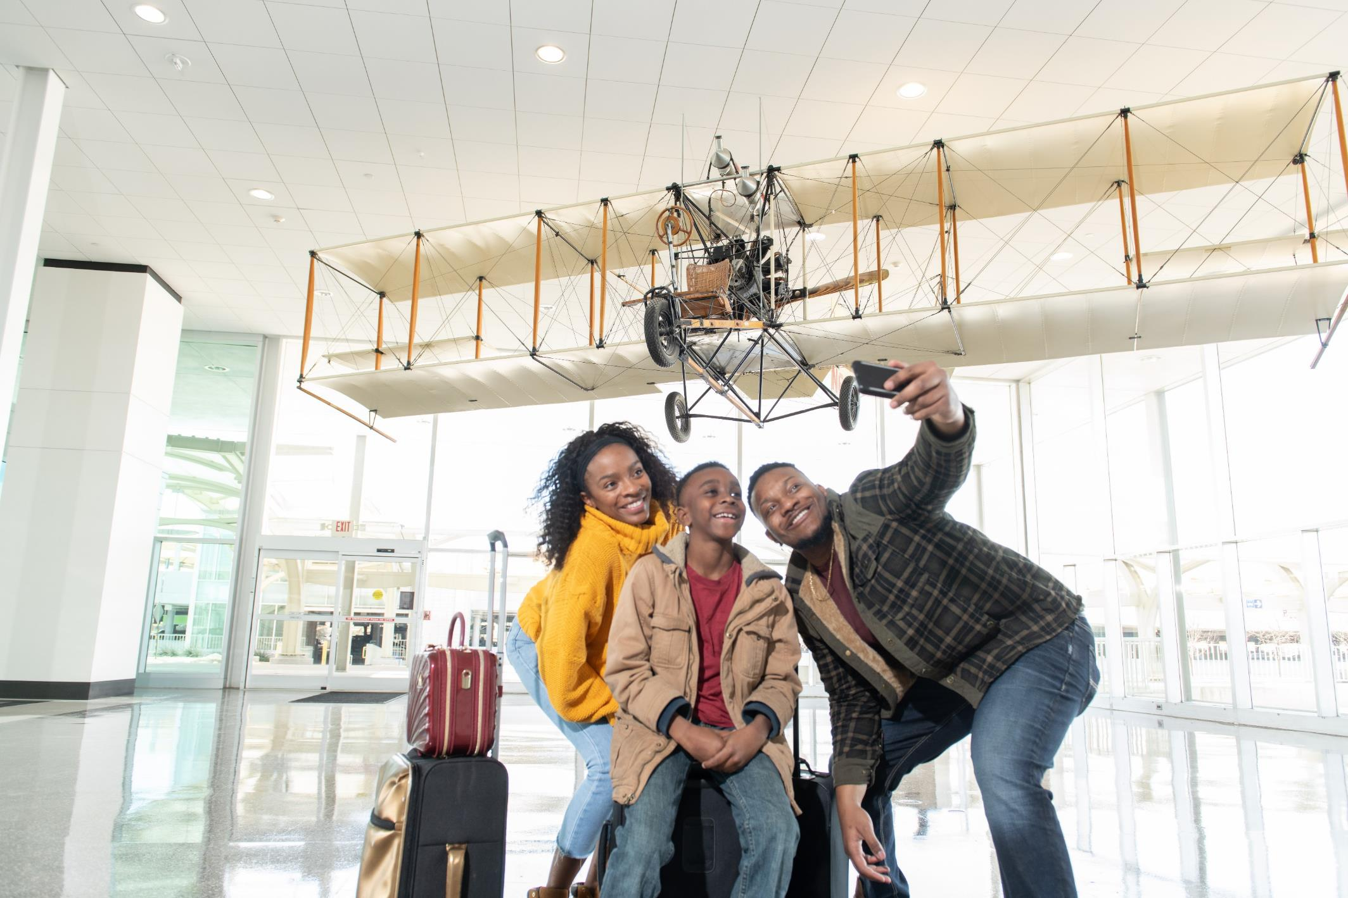
Questions?
Questions?

Slide 51
Facebook: @TulsaAirports
Twitter: @tulsaairports
Instagram: @flytulsa
Tik Tok: @flytulsa
Let’s be social.

