Slide 1
A Trip To Tulsa International Airport
A Social Story

Slide 2
We will start out by driving to Tulsa International Airport and parking our car. Then we will go inside
and go to the counter to check-in and get our boarding pass.
It is very important to stay very close to my family while at the airport.

Slide 3
Security Checkpoint
After getting our boarding passes we will walk to the security checkpoint where we might have to wait in another line to go through the security checkpoint.
The Security Checkpoint has many nice TSA Officers who check to make sure that no one who gets on a plane has anything that could be unsafe for air travel.
First, we give our boarding passes and I.D., if we are old enough to have one, to a TSA Officer.

Slide 4
Security Checkpoint
Then if we are 12 or older, we will have to take our shoes off and put them in a white box.
Everyone will need to put everything in their pockets, coats, toys and bags in the white boxes and place them on the conveyor belt. A TSA Officer will look at the items in the boxes with an x-ray machine.

Slide 5
Security Screening
While our toys and bags are going for a ride on the conveyor belt and being x-rayed, we will be screened.
If we are under 12, we will walk through the grey security doorway called a magnetometer. If the machine beeps it means that we did not remove everything from our pockets and we will need to try again.
If the doorway beeps again the TSA officers might end up helping us check our pockets. They call this a pat down.

Slide 6
Security Screening
If we are over 12, we will step inside a different machine called a scanner. We will need to put our feet on top of the foot prints on the floor and hold our arms over our head for 3 seconds.
It is important to hold very still. The scanner will make a quiet wooshing sound as it scans us. When it is ok to move again the TSA Officer will tell us to step out of the machine.

Slide 7
Security Screening
When we are done being screened we will get our shoes and toys back.
After we put our shoes back on, we will walk to our gate.

Slide 8
We will wait at the gate until it is our turn to get on the plane. We can sit and play with one of our toys that we brought with us or maybe even have a snack while we wait.

Slide 9
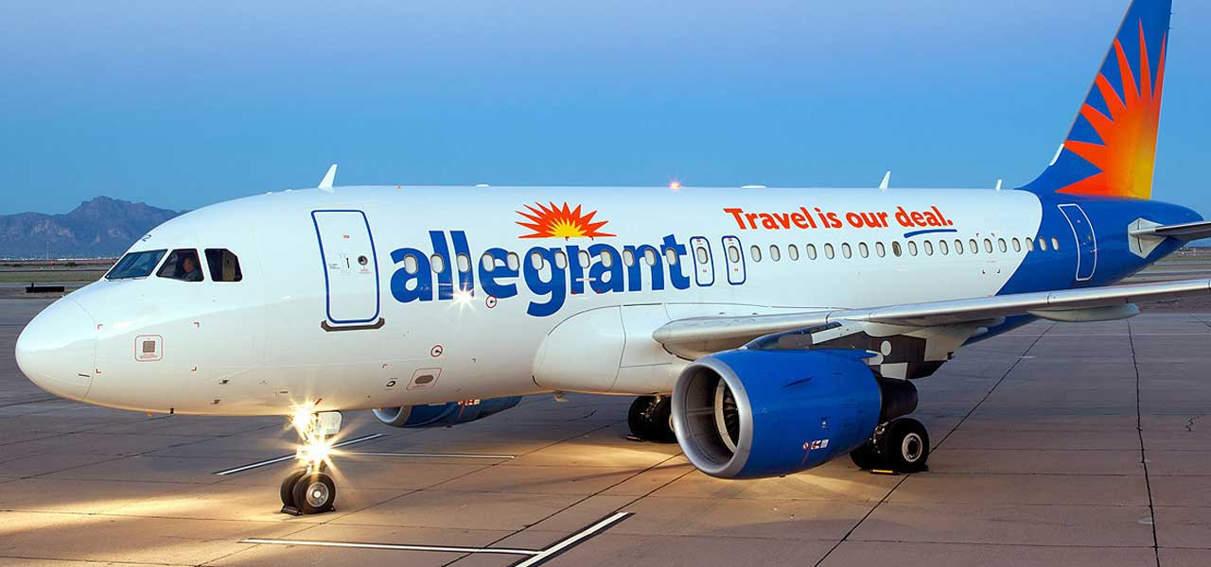
Wow! look at this airplane that we get to get on!

Slide 10
Boarding the Airplane
When it is time to get on the plane we will wait in line again this time in front of a big window where we can see outside.
When it is our turn we will give our boarding pass to the person at the door.
Then we will walk down the big long hallway called a jet bridge to the airplane. We might have to wait our turn in line to get on the airplane.

Slide 11
Boarding the Airplane
When we get on the airplane we will find our seat numbers, put our bigger bags in the overhead bins and our smaller bags under the seat in front of us.
We will sit in our seat and fasten our seat belts. While we are sitting we can play with toys or read books.

Slide 12
Success!
While we are on the airplane the flight crew will tell us things about the plane.
After sitting on the airplane for a little while we will take off our seat belts, get our bags and wait our turn to get off of the airplane.
We did it! Now we know how to board an airplane!
Good job everyone!

